Slide 1
Monday, August 7, 2017
Write In Your Agenda:
Write In Your Monitoring Log:
CW:
Metric Mania Conversion Practice
HW:
Metric Monster
-rough=Tues, 8/8
-final=Mon, 8/14
Response to Warm-Up:
Right now, do you think your monster is GREAT, GOOD, or FAIR? Explain.
You will need:
Pencil
Agenda
New Monitoring Log (pink paper)

Slide 2
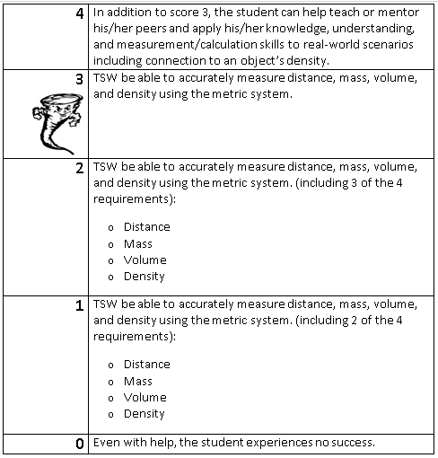
Learning Goal and Scale
TSW be able to describe how the Earth is connected to and affected by other objects in the solar system (including its movement, its relative position to other objects, its seasons, and visible constellations).

